Slide 1

Data Science and the Context of Big Data
FDP on “Data Analytics using Python/R Programming
National Institute of Technology, Puducherry, Karaikal
Dr.T.V.Geetha, Senior Professor (Retired),
UGC BSR Faculty Research Fellow
Department of Computer Science & Engineering
College of Engineering, Guindy, Anna University Chennai
23rd August 2021

Slide 2
Outline of the Talk
Introduction
What is Data Science?
Data Science versus ……
Data Science Process
Roles and Skills of a Data Scientist
Aspects of Data Science
Lessons
Principles
Data Science in the Context of Data Science
Big data
Big Data and Analysis
Applications & Use cases

Slide 3
Introduction

Slide 4
What is Data Science?
Data Science is the science which uses computer science, statistics and machine learning, visualization and human-computer interactions to collect, clean, integrate, analyze, visualize, interact with data to create data products.
Data Science is a concept to unify statistics, data analysis, machine learning and their related methods in order to understand and analyze actual phenomena with data
Data Science is about querying the past, present and the future

Slide 5
Analysing Data
Statistics
Data Mining
Knowledge Discovery in Data
Business Analytics
Predictive Analytics
Data Analytics
Data Science
Big Data
Core:
Finding Useful Patterns in Data
Different Emphasis

Slide 6
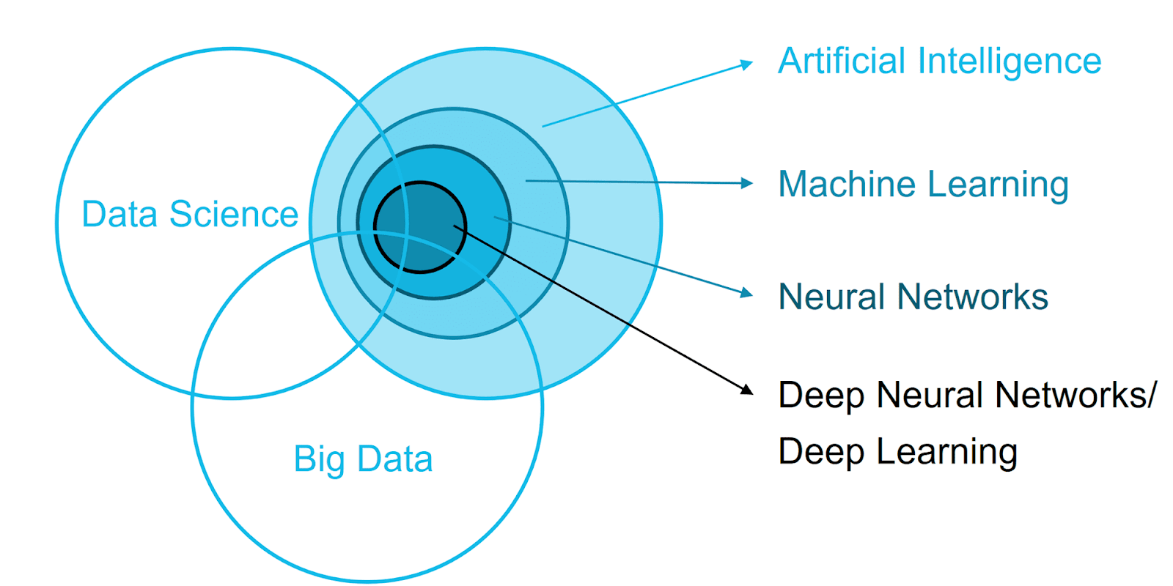

Slide 7
Data Science –AI-Machine Learning – Data Analytics – Big Data Analytics
 | Data Science | AI | Machine Learning | Data & Business Analytics | Big Data Analytics
Goal | Analysis of data and drawing meaningful insights – through statistical & algorithmic methods | Make machines intelligent enough to work based on environment | Recognize patterns in data through algorithms that learn & perform well on unseen data | Examine datasets in order to draw conclusions using specialized software | Mine and analyse voluminous amounts of structures & unstructured data for business gains
Focus | Discover new questions to drive innovation –Macro - Actionable insights from data | Maximize chance of Success | Maximize Accuracy | Use existing data to uncover Actionable Data -Micro -Reports, Trends | Patterns, Correlations, Models
Process | Explore many models, build and tune hybrids to aid decision making in organizations | Handles specific tasks using intelligent processing | Uses a variety of algorithms & Analytical Models to support pattern discovery | Cleansing, Transforming and Modelling data Static, Comparative | Exploratory, Experimentation, Visual
Data Sources | Data –structured & unstructured, Internal & external sources | Limited Domain specific data | Improve/validate on a few, relatively clean, small datasets | Pre-planned, added slowly | On-the-fly, as-needed

Slide 8
Ask relevant Questions and define objectives for the problem that needs to be tackled
Data Science
1
Business Understanding
2
Data Mining
3
Data Cleaning & Exploration
4
Feature Engineering
5
Predictive
Modelling
6
Visualization
Communicate the findings with key stakeholders using plots and interactive visualization
Gather and scrape the data necessary for the project
Fix inconsistencies within the data & form hypothesis about defined problem by visually analysing the data
Train machine learning models evaluate their performance and use them to make predictions
Select important features and construct more meaningful ones using the raw data that you have

Slide 9
Data Science – A Continuous Process
Business Understanding
Data
Understanding
Data
Preparation
Deployment
Data
Modelling – Building Predictive Models
Evaluation

Slide 10
Data Science Process
Discovery:
Discovery step involves acquiring data from all the identified internal & external sources which helps you to answer the business question.
Logs from webservers
Data gathered from social media
Census datasets
Data streamed from online sources using APIs
Preparation:
Data can have lots of inconsistencies like missing value, blank columns, incorrect data format which needs to be cleaned. You need to process, explore, and condition data before modeling. The cleaner your data, the better are your predictions.
Model Planning:
In this stage, you need to determine the method and technique to draw the relation between input variables. Planning for a model is performed by using different statistical formulas and visualization tools. SQL analysis services, R, and SAS/access -tools

Slide 11
Data Science Process
Model Building:
In this step, the actual model building process starts. Here, Data scientist distributes datasets for training and testing. Techniques like association, classification, and clustering are applied to the training data set. The model once prepared is tested against the "testing" dataset.
Operationalize:
In this stage, you deliver the final baselined model with reports, code, and technical documents. Model is deployed into a real-time production environment after thorough testing.
Communicate Results
In this stage, the key findings are communicated to all stakeholders. This helps you to decide if the results of the project are a success or a failure based on the inputs from the model.

Slide 12
The Academic Data Science Process
Ask an Interesting Question `
Explore the Data `
Get the data `
Plot the data. Anomalies? Patterns?
What is the scientific Goal? What to Predict?
How is data sampled?
Which data are relevant?
Privacy Issues
Communicate & Visualize the results
Model the data `
What did we learn? Do results make sense? Can we tell a story?
Build, Fit & Validate Model

Slide 13
Roles required in a Science Project
Data Scientist
Prove / Disprove Hypothesis
Information and Data Gathering
Data Wrangling
Algorithm and ML Models
Communication
Data Engineer
Build Data Driven Platforms
Operationalize Algorithms and ML Models
Data Integration
Visualization Expert
Build Dashboards and other data Visualization Driven Platforms
Provide Insight Through Visual Means
Project Owner
Project Management
Manage Stakeholder Expectations
Maintain a Vision
Facilitate

Slide 14
Data Scientist – Must–Have Skills
Skills
Maths & Statistics
Machine Learning
Statistical Modelling
Exploratory Analysis
Clustering
Regression Analysis
Programming and Database
Computer Science DBMS
Data Visualization
Python & R Programming
Big Data
Domain Knowledge & Soft Skills
Inclination for business operations
Keen on working with data
Problem Solver
Strategic proactive & cooperative
Interested in hacking
Communication & Visualization
Story Telling
Convert data-based insights into Decisions
Collaborate with Management
Visual Art Design

Slide 15
Aspects of Data Science

Slide 16
Lessons
Lesson 1 – It is an Iterative Circular Process
Waterfall Model does not work for Data Science
Lesson 4 – Focus on the Right Metric – Actionable
Focus on persuadables
Churn may depend on age, region, usage and rate plan – Rate plan easiest to change
Right Metric – Uplift Modelling – Model not when consumer will buy – but will buy in response to an offer
Lesson 2 – Data Engineering Takes the Bulk of the Time
Building Machine Learning/ Predicting Model – small part
60-80% spent on Data Preparation /Engineering
Lesson 5 – Be a Fox, not a Hedgehog
Be a Fox who knows everything – not a Hedgehog who knows one important thing
Lesson 3 – Question Assumptions

Slide 17
Lessons
Lesson 6 – Avoid Overfitting
Find simplest possible hypothesis
Adjusting False Discovery Rate
Randomization Testing
Nested Cross Validation (Train, Test, Holdout)
Regularization (adding a penalty for complexity)
Lesson 8 – Limits to Predicting Human Behavior
Inherent randomness, complexity in human behaviour
Individual Predictions have limited accuracy
Aggregate predictions more accurate – because individual randomness cancels out
Real-time behaviour data more predictive than historical demographic data
Lesson 7 – Tell a Story
Combine Facts into a story
Combine Visual & text representation
Explanation gives Credibility
Dynamic /Interactive
Lesson 9 – Deployment & Maintenance

Slide 18
Lessons
Lesson 10 – Don’t just Predict, Optimize
Predicting is usually just one part of making a decision
Consider cost, frequency, latency, human behaviour, etc..
Goal : Optimization
Privacy is Important in the age Big Data

Slide 19
Basic Principles
Focus on Actionable Patterns
Build Predictive Models -Supervised Learning – Train –Test - Validate
Avoid Overfitting
Calculate Similarity between Entities – Unsupervised Learning
Avoid Information Leakers
Select Important Variables / Features
Model Accuracy vs lift – how much more prevalent a pattern is than would be expected by chance
Estimate Probability & Cost / Gain of Actions
Help Optimize Decisions

Slide 20
Data Science in the Context of Big Data

Slide 21
Data Science with Big Data
Data Munging - procedure for transforming data from erroneous or unusable forms, into useful and use-case-specific ones and Data wrangling - process of cleaning and unifying messy and complex data sets for easy access and analysis - becomes more complex
New Algorithms, Technology needed to deal with Big Data Volume, Velocity & Variety)
New Effective Algorithms that require Big Data – Deep neural Networks & Recommendations
New things becomes Visible – Social networks, recommendations, mobility, knowledge
Basic Principles Remain

Slide 22
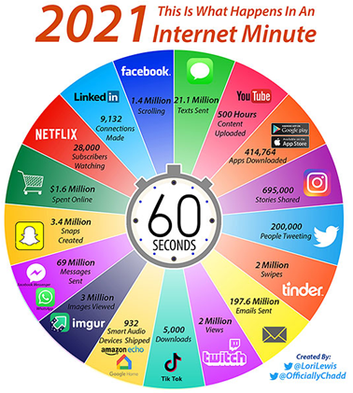

Slide 23

Big Data is all about
better Analytics on a broader spectrum of data, and therefore represents an opportunity to create even more differentiation among industry peers.
high-volume, high-velocity and high-variety information assets that demand cost-effective, innovative forms of information processing for enhanced insight and decision making.
Notes:
Jervin:
BigData is not NEW, it’s been around for years and one way or another your organization already has big data e.g. DW.
However, Big Data Is more than just a DW that requires to store/analysis large volume of data..
BigData is not just about Volume of data that resides in DW today.. The volume could be batch and realtime (trigger feed)

Slide 24
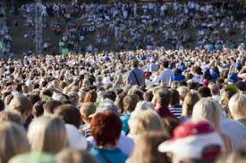
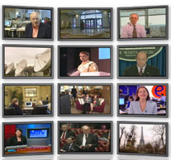


The Model Has Changed…
The Model of Generating/Consuming Data has Changed
Old Model: Few companies are generating data, all others are consuming data.
Generating Data of all Sorts
New Model: all of us are generating data, and all of us are consuming data

Slide 25

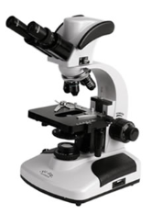
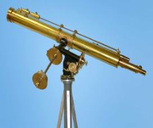

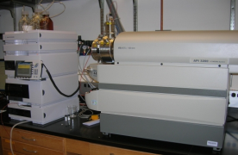
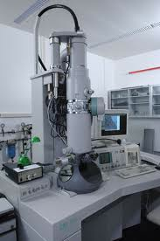

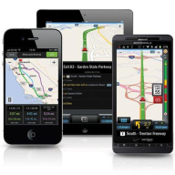
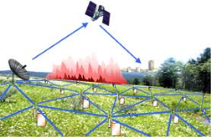

Data From Everywhere
Activity Data – listening to music – reading eBooks – smart phone (how you use it) – web browser (what you are searching for) – credit card (where you shop) – shop (what you buy) – every activity generating data
Social media &networks
(all of us are generating data)
Conversation Data - -leave a digital trail – social media- Facebook / Twitter – Phone conversations recorded
Photo and Video Image Data - Pictures we take on mobile & cameras – post on social media sites – CCTVs – video images – up-load – hundreds of hours of video - YouTube
Scientific instruments
(collecting all sorts of data)
Sensor Data –surrounded by sensors - mobile – GPS location every second – accelometer – track speed – direction – many devices
IOT Data – Smart TVs, smart watches, fridges, alarms – collect and process data – IOT connects –traffic sensors to your alarm clock – wake you earlier – if road blocked
Sensor technology and networks
(measuring all kinds of data)
Mobile devices
(tracking all objects all the time)

Slide 26

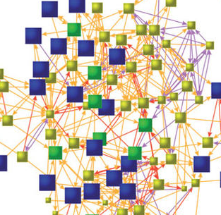



Big Data “proxies” of social life
Shopping Patterns & Lifestyle
Relationships and Social Ties
Movements
Desires, opinion & Sentiment

Slide 27






Innovative Organizations Unlock Value from Big Data Stores
Mobile & Digital Media
Embedded Pentaho to measure massive volumes of mobile and event data generated from mobile devices stored in MongoDB
Online Retailer
Understanding the buying patterns of 5 million users from click stream data stored in Hadoop & HBase
Gaming
Better monetization of premium game features through analyzing large volumes of player data - stored in MongoDB & Infobright
Travel & Entertainment
Helping thousands of travel partners like expedia.co.uk and thomascook.fr improve promotional targeting using Hbase and Hadoop
Social Commerce
Better campaign performance through monitoring social media, page clicks and email marketing data stored in HP Vertica
Healthcare
Embedded Pentaho to better patient care & compliance through analysis of unstructured digital pen data stored in CouchDB
Notes:
TAKE-AWAYS
Pentaho has many big data customers across a range of industries and big data platforms.

Slide 28
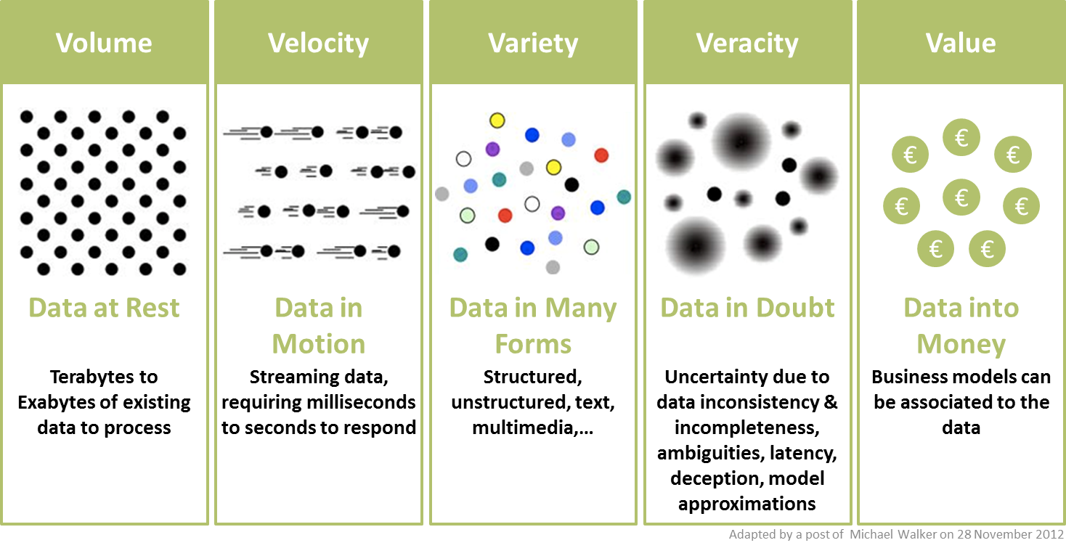
Characteristics of Big Data - 5V’s of Big Data

Slide 29
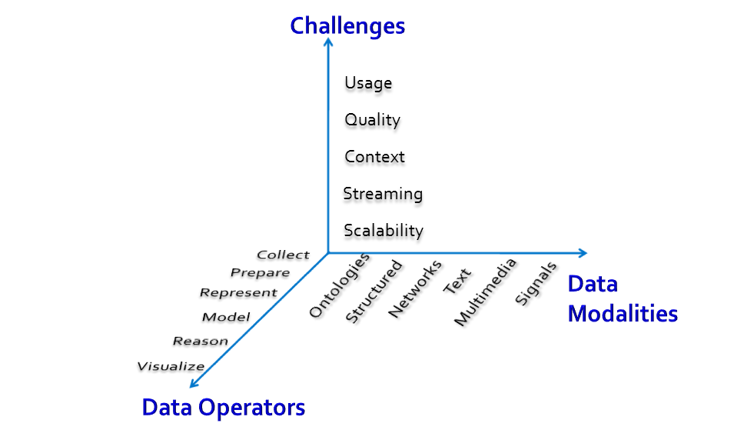
What Matters when dealing with data?
J. Leskovec, A. Rajaraman, J. Ullman “Mining of massive datasets”.

Slide 30
Big Data and Analytics

Slide 31
Analytics Lifecycle
Business Understanding
Gathering problem information
Defining the goal to solve the problem
Defining expected output
Defining hypothesis
Defining analysis methodology
Measuring the business value
Data Understanding
Define variables to support hypothesis
Cleaning & transforming the data
Create longitudinal data/trend data
Ingesting additional data if needed
Build analytical data mart
Data Mining & Modelling
Defining target variable
Splitting data for training and validating the model
Defining analysis time frame for training and validation
Correlation analysis and variable selection
Selecting right analytic algorithm
Do validation by measuring accuracy, sensitivity, & model lift

Slide 32
Definitions – Big Data Analytics
BIG DATA ANALYTICS
examining large and varied data sets
analyzing large volumes of data
from multiple and varied sources, including transactional data and other structured data.
Sources
gathered from a wide variety of sources, including social networks, videos, digital images, sensors, and sales transaction records.
BUSINESS PERSPECTIVE
effective marketing campaigns, the discovery of new revenue opportunities, improved customer service delivery, more efficient operations
INSIGHT
uncover hidden patterns, unknown correlations, market trends, customer preferences
uncover patterns and connections that might otherwise be invisible - provide valuable insights about the users who created it
BDA-PROFESSIONALS
analytics professionals, such as data scientists and predictive modelers - ability to analyze Big Data
WHY
help organizations make more-informed business decisions-
gain an edge over their rivals and make superior business decisions.

Slide 33










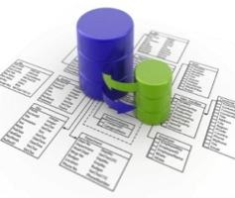
The Big Data Approach to Analytics is Different
Traditional Analytics Structured & Repeatable Structure built to store data
Big Data Analytics Iterative & Exploratory Data is the structure
Business
Users
Determine
Questions
IT Team
Delivers Data
On Flexible
Platform
Analyzed Information
Available Information
Analyze ALL Available Information
Capacity constrained down sampling of available information
Whole population analytics connects the dots
Analyzed Information
Analyzed Information
Business
Users
Explore and
Ask Any Question
IT Team
Builds System
To Answer
Known Questions
Carefully cleanse small information before any analysis
Analyze information as is & cleanse as needed
The big deal about Big Data, IBM
33
Notes:
Both analytic approaches and valid and complementary
Traditional approach – Business users determine what questions to ask and IT structure the data to answer that question. This is well suited to many common business processes, such as monitoring sales by geography, product or channel; extract insight from customer surveys; cost and profitability analyses.
- Allows organization to answer questions that will be asked time and time again.
The Big Data approach – IT delivers a platform that consolidates data sources of interest and enables creative discovery. Then the business users use the platform to explore data for ideas and ask any question.
- Allows users to explore data in a more analytic way … the answers to questions spawn new questions to be asked.

Slide 34





The Big Data Approach to Analytics is Different
Traditional Analytics Structured & Repeatable Structure built to store data
Big Data Analytics Iterative & Exploratory Data is the structure
Hypothesis
Question
Data
Exploration
?
All Information
Analyzed Information
Answer
Data
Actionable Insight
Correlation
Start with hypothesis
Test against selected data
Data leads the way Explore all data, identify correlations
Analyze after landing…
Analyze in motion…
The big deal about Big Data, IBM
34
Notes:
Both analytic approaches and valid and complementary
Traditional approach – Business users determine what questions to ask and IT structure the data to answer that question. This is well suited to many common business processes, such as monitoring sales by geography, product or channel; extract insight from customer surveys; cost and profitability analyses.
- Allows organization to answer questions that will be asked time and time again.
The Big Data approach – IT delivers a platform that consolidates data sources of interest and enables creative discovery. Then the business users use the platform to explore data for ideas and ask any question.
- Allows users to explore data in a more analytic way … the answers to questions spawn new questions to be asked.

Slide 35
Paradigm Shifts Enabled by Big Data Leverage more of the data being captured
Traditional Approach
Big Data Approach
Analyzed information
All available information analyzed
All available information
Analyze small subsets of data
Analyze all data
Big Data: Turning Data Into Insights, IBM
Notes:
35

Slide 36






Paradigm Shifts Enabled by Big Data Reduce effort required to leverage data
TRADITIONAL APPROACH
BIG DATA APPROACH
Data
Understand
Data
Govern to Perfection
Repository
Use
Use
Govern Appropriately
Understand data and usage, govern to the appropriate level, use it, and iterate
Govern Data to the Highest Standard, Store it, then use it for multiple purposes
Big Data: Turning Data Into Insights, IBM
Notes:
36

Slide 37


Paradigm Shifts Enabled By Big Data Data leads the way—and sometimes correlations are good enough
Traditional Approach
Big Data Approach
Hypothesis
Question
Data
Exploration
Answer
Data
Insight
Correlation
Start with hypothesis and test against selected data
Explore all data and identify correlations
Big Data: Turning Data Into Insights, IBM
Notes:
37

Slide 38
Paradigm Shifts Enabled By Big Data Leverage data as it is captured
Traditional Approach
Big Data Approach
Data
Analysis
Data
Repository
Analysis
Insight
Insight
Analyze data after it’s been processed and landed in a warehouse or mart
Analyze data in motion as it’s generated, in real-time
Big Data: Turning Data Into Insights, IBM
Notes:
38

Slide 39
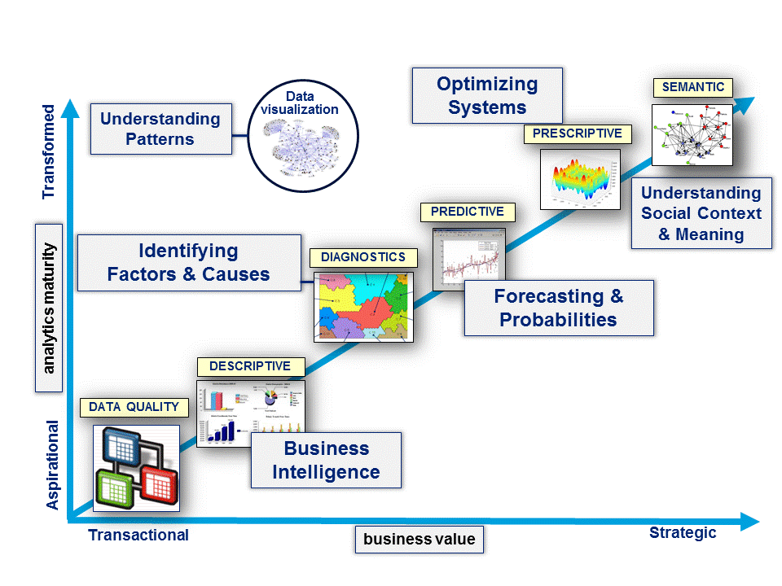
Types of Analytics
v
https://sctr7.com/2014/07/09/twelve-emerging-trends-in-data-analytics-part-1-of-4/

Slide 40
Applications

Slide 41
Most Common Predictive Models
Clustering – Finding Groups and predicting themes
Classification – most common Decision Tree
Association – Multi-Assurance Connected Buckets
Link Analysis – Relationships
Text Mining – Unstructured Data to Meaning
Time Series – Predicting a continuous Value
Graph Structure – Structure Predicts Behavior

Slide 42
Common Big Data Use Cases
Recommend friends/dates/products
Classify content into predefined groups
Find similar Content
Find associations/patterns in actions/ behaviors
Identify key topics/summarize text – documents & corpora
Detect anomalies / fraud
Ranking search results
Others?

Slide 43


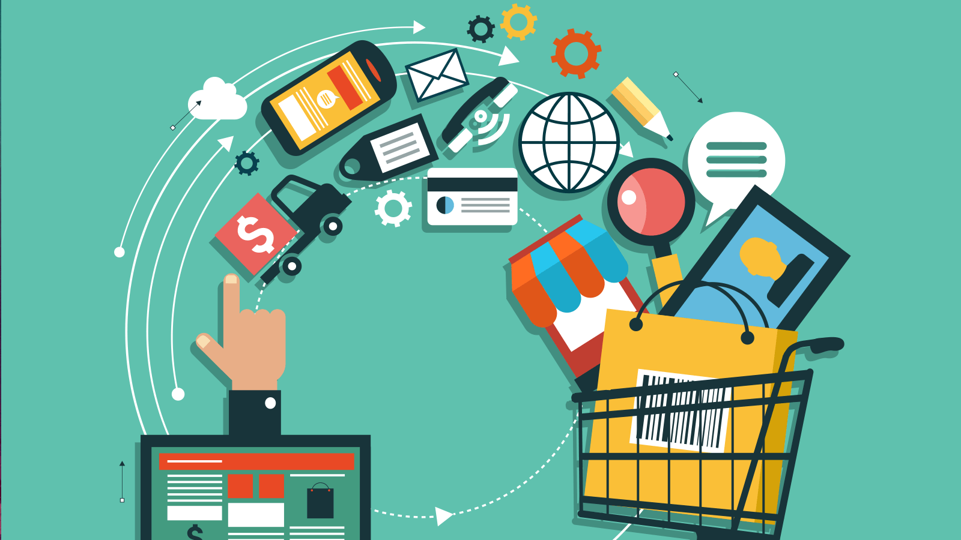
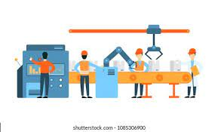


Data Science Applications
Finance
Transportation
E-commerce
Customer Segmentation
Strategic Decision Making
Algorithmic Trading
Risk Analysis
Self-driving cars
Enhancing Driving behaviour
Car Monitoring Systems
Enhancing Safety
Identifying Customers
Recommending Products
Analysing Reviews
Manufacturing
Healthcare
Banking
Predicting Potential Problems
Monitoring Systems
Automating Manufacturing Units
Maintenance Scheduling
Anomaly Detection
Medical Image Analysis
Drug Discovery
Bioinformatics
Virtual Assistants
Fraud Detection
Credit Risk Modelling
Customer Lifetime Value

Slide 44
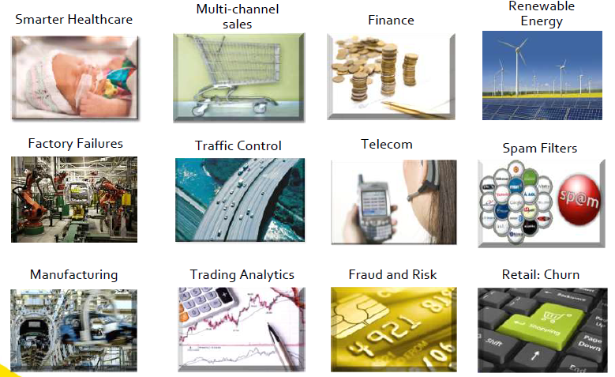
Business Applications of Predictive Analytics

Slide 45
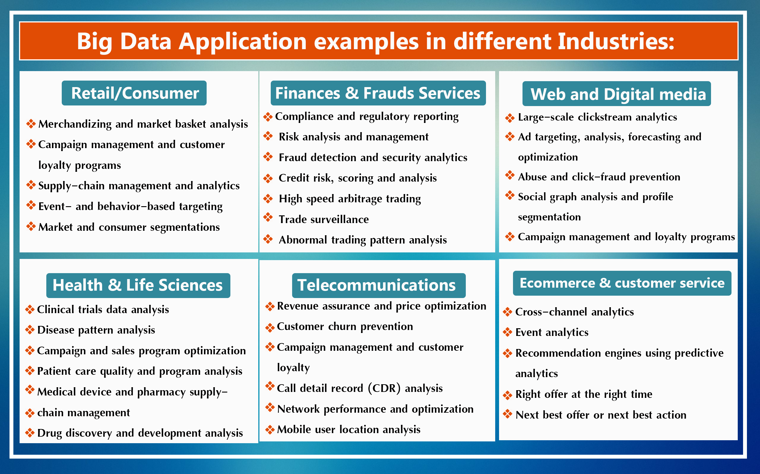

Slide 46
Use Cases from Industry

Slide 47
Use cases – Type of Business Goals, Problem Types, Types of Industry, Type of Data & Type of Analytics
Optimize Funnel Conversion
Market Basket Analysis and Pricing Optimization
Behavioral Analytics
Predict Security Threats
Customer Segmentation
Fraud Detection
Predictive Support
Industry Specific

Slide 48

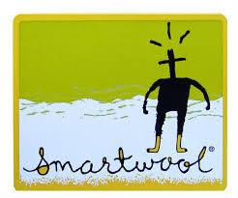
Optimize Funnel Conversion
To learn insights on how the sales conversion process can be improved
To track leads through the entire sales conversion process, from a click on an adword to the final transaction.
Increase in Checkout
Adding a frequently asked questions section to product pages: increases conversions
Bringing some of the offline world online and experiment with adding sizing tips to product pages.
Placing the image below the product information increased checkouts
Industry – Sports Products
Click and Sales Data
Diagnostic & Prescriptive
Increase in Revenue
Use a well-defined grid layout for online shopping experience: Uniform product page.
Use repetitive image attributes to enable better eye tracking when scanning a number of products.
Industry – Clothing
Design, Shopping Patterns
Diagnostic

Slide 49


Behavioral analytics
With data on consumer behavior -learn
what prompts a customer to stick around longer,
About customer’s characteristics and purchasing habits in order to improve marketing efforts and boost profits.
Optimize Restaurant - Target Customers
Collects data on its customers’ purchasing habits in order to send personalized ads and coupon offers to the consumers’ mobile phones.
The company also identifies trends indicating whether customers are losing interest in their product and directs offers specifically to those customers in order to regenerate interest.
Industry – Food and Beverage
Purchase Data
Prescriptive & Decisive
Customer Behavior
Optimize Restaurant to particular Market
McDonalds tracks vast amounts of data in order to improve operations and boost the customer experience. The company looks at factors such as the design of the drive-thru, information provided on the menu, wait times, the size of orders and ordering patterns in order to optimize each restaurant to its particular market.
Industry– Food & Beverage
Design, Menu, wait times, size, Ordering Patterns
Descriptive & Prescriptive

Slide 50


Customer Segmentation
With data on consumer behavior from multiple sources such as social media data , transaction history - companies segment and target their customers and start to make personalized offers to those customers.
Customer Sentiment
Combines public data, social data and internal data to monitor what customers and friends of customers are saying about a particular product online.
Retailer uses this data to send targeted messages -product, and discount offers.
data analysis to identify the context of an online message, such as if a reference to “salt” is about the movie or the condiment.
Industry – Retail
Multi-source Data
Diagnostic & Predictive
Segments customer based on
Demographic- Name, gender, age, address, occupation, date of birth, social class, phone number, e-mail,…
Psychographic - Interests, values, lifestyle, culture preferences, religion, etc.
Behavioristic -Activities and habits of online stores usage.
Industry – eCommerce
Multi-source Data
Diagnostic & Prescriptive

Slide 51


Predictive Support
Through sensors and other machine-generated data can identify when a malfunction is likely to occur.
Can then preemptively order parts and make repairs in order to avoid downtime and lost profits.
Product Support
Analyses sensor data on their planes in order to identify patterns that indicate a potential malfunction or safety issue.
address potential problems and make necessary repairs without interrupting flights or putting passengers in danger.
Industry – Travel
Sensor Data
Diagnostic
Application Support
Uses real-time wire data analytics to detect problems in its applications and prioritize which issues should be addressed first.
Uses big data to determine the impact of a particular market event, as well as its original cause.
Industry – Financial
Real-time Data
Predictive

Slide 52


Market Basket Analysis
By quickly pulling data together from multiple sources, retailers can better optimize their product selection and pricing, as well as decide where to target ads.
Product Design
Uses simulation models & predictive analytics -to create the best design for products.
Creates & sorts through iterations -to develop the best design for a disposable diaper.
Uses predictive analytics to determine how moisture affects the fragrance molecules in dish soap, so the right fragrance comes out at the right time in the dishwashing process.
Industry – Household Retail
Real-time Data
Predictive
Product Quality
Uses an algorithm - ensure -orange juice has a consistent taste throughout the year.
incorporates satellite imagery, crop yields, consumer preferences and details about the flavours that make up a particular fruit in order to determine how the juice should be blended.
Industry – Food
Satellite image, crop yield, consumer Data
Diagnostic

Slide 53


Predict Security Threats
Track trends in security breaches and allow companiesto proactively go after threats before they strike.
Victim Detection
Analyzed criminal activities at ATMs to determine factors that increased the risk of victimization.
Weather conditions and proximity of highways, affect the risk of security threat.
Industry – Finance
Victimized ATM Data
Diagnostic &Predictive
Predict Item Theft
With more than 1.5 billion items in its catalog-keep track of and protect.
It uses its cloud system, S3, to predict which items are most likely to be stolen, so it can better secure its warehouses.
Industry – Online Retail
Cloud Data
Predictive

Slide 54


Fraud Detection
Financial firms use big data to help them identify sophisticated fraud schemes by combining
multiple points of data.
Fraudulent Activity
Uses data analytics to detect anomalies across channels that indicate potential fraud.
The fraud team receives data from 140 sources—some in real-time—to monitor activity, such as if a customer makes a mobile banking transaction at the same time as a branch transaction.
Industry – Finance
Real –Time Data
Diagnostic &Predictive
Fraudulent Claims
Uses big data analytics to identify fraudulent claims and possible fraudulent prescriptions.
For example, it can identify if a healthcare provider is charging for a more expensive procedure than was actually performed.
Industry –Insurance
Claim Data
Predictive

Slide 55


Industry Specific
Virtually every industry has invested in big data to help solve specific challenges those industries face.
Healthcare, for example, uses big data to improve patient outcomes, and agriculture uses data to boost crop yields.
Price Prediction
Uses big data analytics to create a predictive model that tells users if the price for a particular flight will go up or down within the next week.
Uses search queries to find cheapest flights, popular destinations & busiest airports.
Improved by tracking the flights to see if its predictions are correct.
Industry – Travel
Real –Time Data
Predictive
Operation Efficiency
Uses sensor data to map its oil and gas wells -increase output & boost efficiency of its operations.
Data received from sensors - analyzed &rendered in 3D and 4D maps.
Industry – Oil
Sensor Data
Diagnostic

Slide 56


Industry Specific
Healthcare Quality
Analyzes data on groups of patients with similar medical conditions, to reveal trends in the diseases and to identify the right candidates for medical research.
The real-time data analysis allows Aurora to predict and improve patient outcomes and reduce readmissions.
Industry – Health Care
Internal, National and Real-time Data
Diagnostic & Predictive
Increasing Yield & Reducing Cost
Sensors placed on equipment, along with historical and real-time data on soil conditions, the weather and crop features -used together to help farmers.
Determine where and when to plant to get the highest yield, and how to boost the efficiency of their work to reduce fuel costs.
Industry – Farming
Historical, Real time, Sensor Data
Diagnostic

Slide 57
Activity I – Designing Use Cases
Design 2 Use Cases each for the following industries -Describe goal for each case, the data from different sources you think should be used and the type of analytics required
Education
Restaurant Aggregator & Food Delivery (like Swiggy)

Slide 58
Thanks
Any Questions?

